Slide 1

FLIPKART PRODUCT & SALES INSIGHTS
TOOL USED-
MY SQL WORKBENCH
PRESENTED BY-
OISHIKA BOSE

Slide 2
PROBLEM STATEMENT & OBJECTIVE OF THE ANALYSIS
The platform has high sales volume, but performance varies across products, sellers, discounts, and time periods.
Delivery delays, overstocking, and uneven product performance impact customer satisfaction and profitability.
Management lacks clear visibility into key drivers of revenue, demand, and operational efficiency.
Analyze sales, revenue, and profit trends across time and categories.
Identify top and underperforming products and sellers.
Evaluate the impact of discounts and pricing on sales volume.
Assess delivery performance and operational efficiency.
Provide data-driven insights to improve profitability, inventory management, and customer experience.

Slide 3

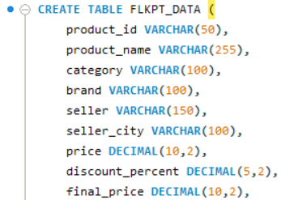
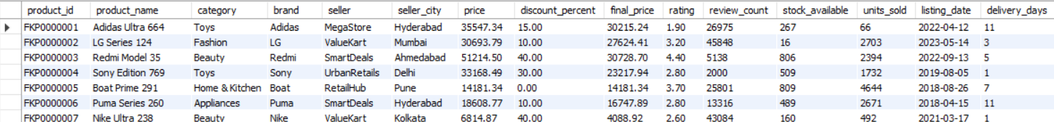
DATASET DESCRIPTION
This dataset captures e-commerce product, seller, pricing, and sales performance data from a Flipkart-like marketplace.
It is designed to support sales analysis, product performance evaluation, seller benchmarking, and pricing strategy insights using SQL.
Did some data cleaning with date formats, deleted unnecessary columns, eliminated null values.
Imported data from command prompt.
Total Rows- 80000, Total Columns- 24
Data Source- Kaggle
Creating
database
Creating
Table for import

Slide 4
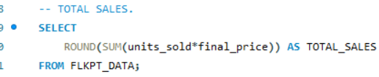

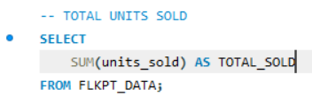



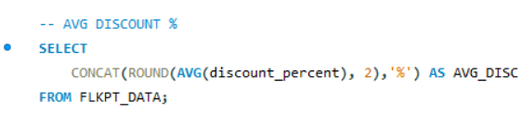

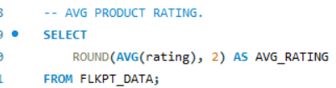

KEY METRICS
Business Questions | Insight
How much total revenue is generated? | Platform generates very high revenue, driven by massive unit volumes and premium pricing.
How many units are sold overall? | 20M+ units sold, indicating strong demand and large customer base.
What is the average selling price? | Avg selling price is ₹23.7K, showing dominance of mid-to-high value products.
How aggressive are discounts? | Avg discount of 21.35%, used as a major sales driver.
How is customer satisfaction? | Avg rating of 3.0, indicating scope for quality & service improvement.

Slide 5
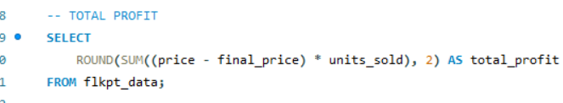

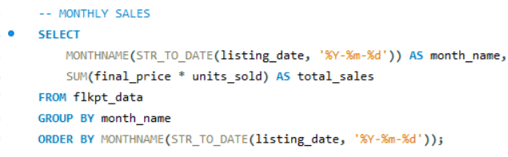
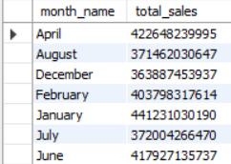
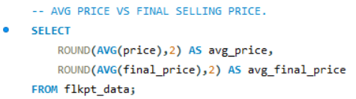

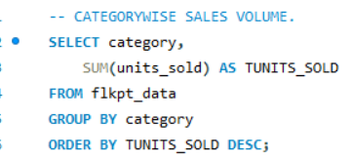
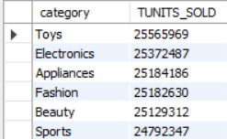
SALES & REVENUE ANALYSIS
Business Questions | Insights
What is the overall profitability? | Very high total profit, indicating strong margins at scale.
Which months generate the highest sales? | January, April, and December are peak months, showing strong seasonality.
Are discounts impacting selling price? | Yes — final selling price is significantly lower than listed price, confirming discount-driven sales.
Which categories sell the most units? | Toys and Electronics lead in sales volume, driving overall demand.
Are all categories performing equally? | Sales volume is concentrated in top categories, while others contribute moderately.

Slide 6
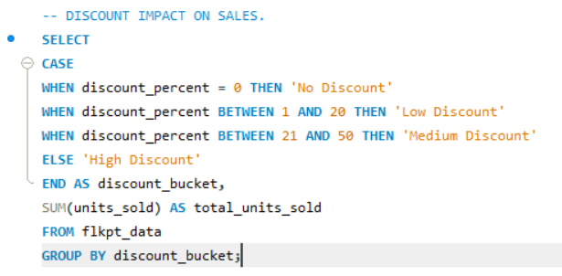

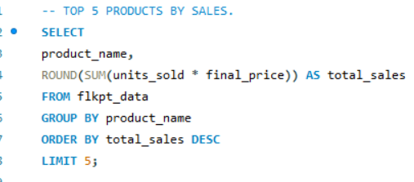
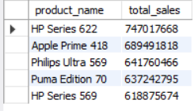
SALES & REVENUE ANALYSIS
Business Questions | Insights
Do discounts increase sales volume? | Yes — Low and Medium discounts drive significantly higher unit sales than no discount.
Which discount range performs best? | Low Discount (1–20%) generates the highest sales volume, indicating optimal pricing.
Which products generate the highest sales value? | A small set of top products contributes disproportionately to total sales.
Is revenue concentrated? | Yes — Top 5 products dominate revenue, indicating product dependency risk.

Slide 7


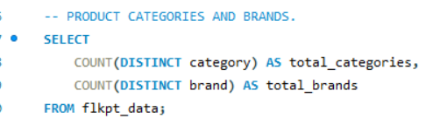

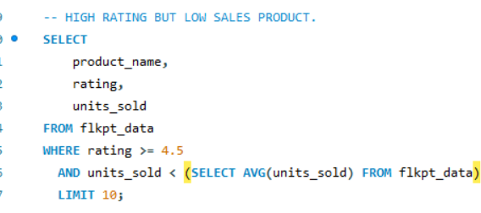
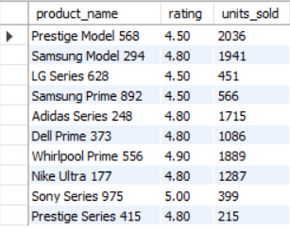
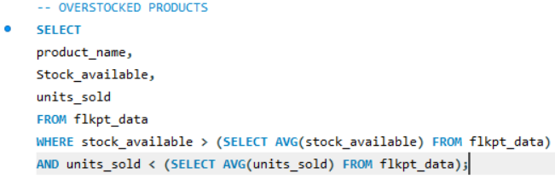
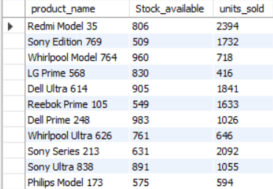
PRODUCT ANALYSIS
Business Questions | Insights
How large is the product portfolio? | 80,000 products indicate a wide assortment strategy.
How diversified is the catalog? | 8 categories and 15 brands, showing moderate brand concentration.
Are high-rated products selling well? | Not always — several high-rated products show low sales, indicating visibility or pricing issues.
Are there inventory inefficiencies? | Yes — overstocked products with low sales suggest working-capital blockage.
Which products need attention? | High-rating & overstocked items are priority candidates for marketing action.

Slide 8
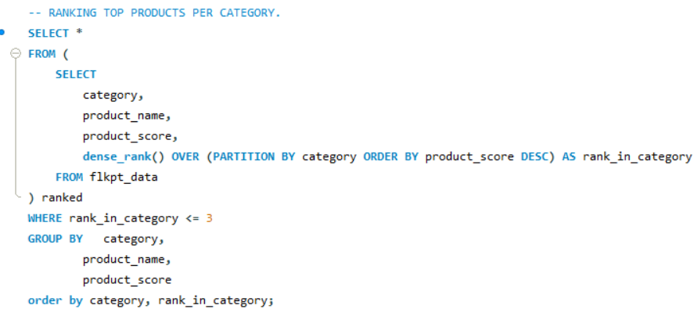
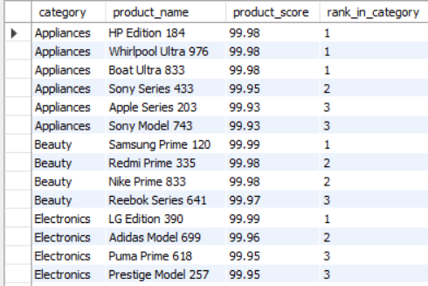
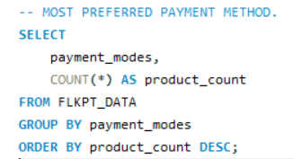

PRODUCT ANALYSIS
Business Question | Insights
Which products perform best by category? | Top 3 products dominate each category, reflecting strong brand trust.
Are leaders evenly spread across categories? | Yes, every category has clear top performers.
Do product scores impact success? | Very high scores (≈99+) directly drive top ranks.
Which payment mode is preferred? | COD is the most preferred payment method.
Is digital payment adoption growing? | Card and UPI usage are nearly equal, showing rising adoption.
Why does COD dominate? | Customers prefer trust and payment security, especially for costly items.

Slide 9
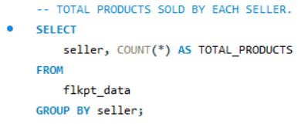
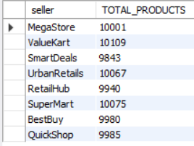
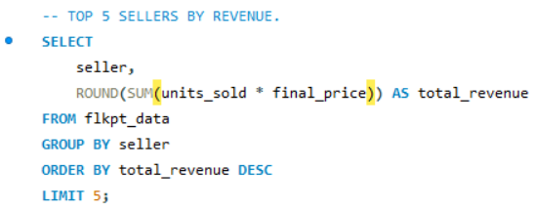
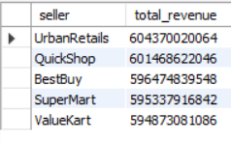
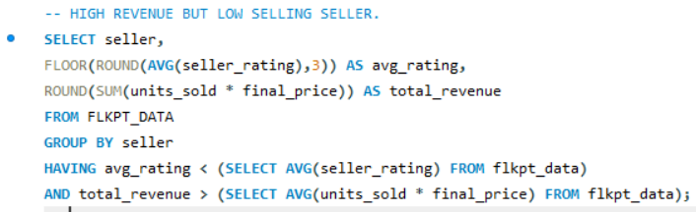

SELLER PERFORMANCE BASED ON CUSTOMER RATINGS
Business Question | Insight
Who are the top revenue sellers? | UrbanRetails & QuickShop lead revenue contribution.
Do more products guarantee higher revenue? | No — efficiency matters more than product count.
Which sellers need intervention? | High revenue but low ratings sellers need quality audits & training.

Slide 10
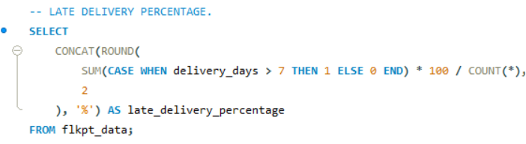

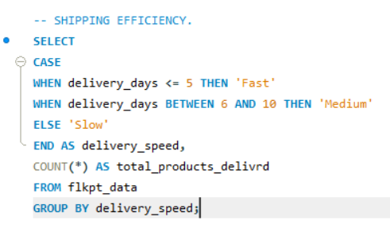
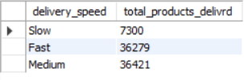
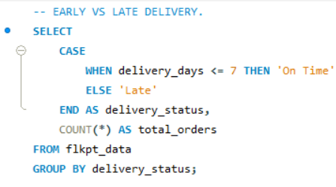

DELIVERY & OPERATIONS
Business Question | Insight
How efficient is delivery performance? | 36.35% late deliveries is operationally high.
What is the dominant delivery speed? | Majority deliveries fall under Medium & Slow buckets.
Does delivery impact customer trust? | High late delivery percentage likely contributes to average ratings (3.0).
Where is process leakage? | Orders exceeding 7 days need logistics optimization.

Slide 11
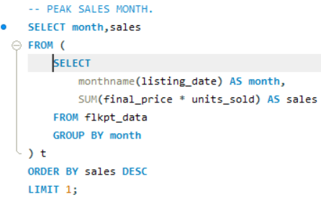

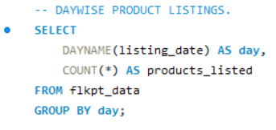
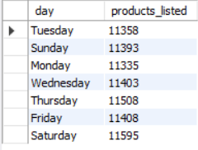
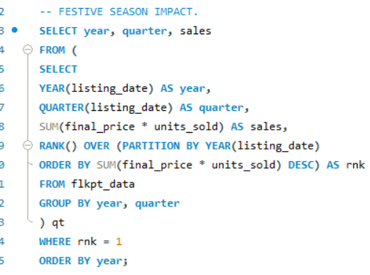
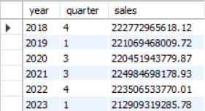
TIME-BASED TRENDS
Business Question | Insight
Which month records the highest sales? | January is the peak sales month, driven by seasonal demand.
On which days are most products listed? | Weekdays outperform weekends, indicating seller-driven activity.
Does festive season impact sales? | Yes, Q4 and Q1 consistently show higher sales spikes.
Are sales evenly distributed across years? | No, sales fluctuate, showing seasonal and annual volatility.
Which periods need focus? | Non-peak months require targeted promotions to stabilize sales.

Slide 12
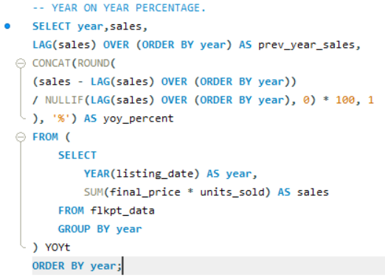
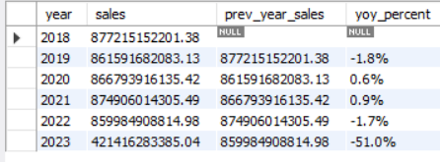
TIME-BASED TRENDS
Business Questions | Insights
Is the business growing YoY? | Growth is inconsistent, with a sharp drop in 2023.
Is growth sustainable? | Current YoY decline signals retention & demand risk.

Slide 13
CONCLUSIONS & SUGGESTIONS
CONCLUSION
BUSSINESS SUGGESTIONS
The platform shows strong revenue and scale, driven by high volumes and discounts.
Sales are concentrated around specific products, sellers, and seasons, increasing dependency risk.
Operational inefficiencies (late deliveries) and average customer ratings threaten long-term growth.
Inventory and product visibility issues prevent high-quality products from reaching full potential.
Fix Delivery Delays – Optimize logistics and enforce seller SLAs.
Boost Product Visibility – Promote high-rated, low-selling products using recommendations.
Control Seller Quality – Monitor low-rating sellers and enforce quality standards.
Optimize Discounts – Use low–medium discounts selectively to protect margins.
Optimize Inventory – Clear overstocked items and improve demand forecasting.

Slide 14

THANK YOU

